Slide 1
Project Title: Wave-Based Computation Using Dynamic Liquid Media and Quantum Simulation
Team Name: Quantum Minds
Mentor: Dr. S. Mohamed Nizar(AP)ECE
Institution: Rajalakshmi Institute Of Technology(RIT)
Team Members:
Akash S
Harish Ganapathy S
Ramya S

Slide 2
Work Completed (Week2)
Finalized the software architecture for the project.
Defined the complete data flow from the LiDAR sensor to Qiskit.
Studied LiDAR interfacing with Raspberry Pi 5.
Researched data acquisition and preprocessing techniques.
Explored feature extraction methods for LiDAR data.
Studied quantum feature encoding and Qiskit workflow.
Compared different low-cost LiDAR sensors and selected
TF-Luna for the prototype

Slide 3
Who Did What?
Harish Ganapathy S
Designed the complete system workflow.
Updated the project documentation and PPT.
Ramya S
Compared low-cost LiDAR sensors (VL53L0X, TF-Luna, TFMini-S).
Studied LiDAR interfacing with Raspberry Pi 5.
Prepared hardware specifications.
Akash S
Studied data preprocessing techniques.
Explored feature extraction methods.
Researched quantum feature encoding.
Studied the Qiskit workflow and data processing pipeline.

Slide 4
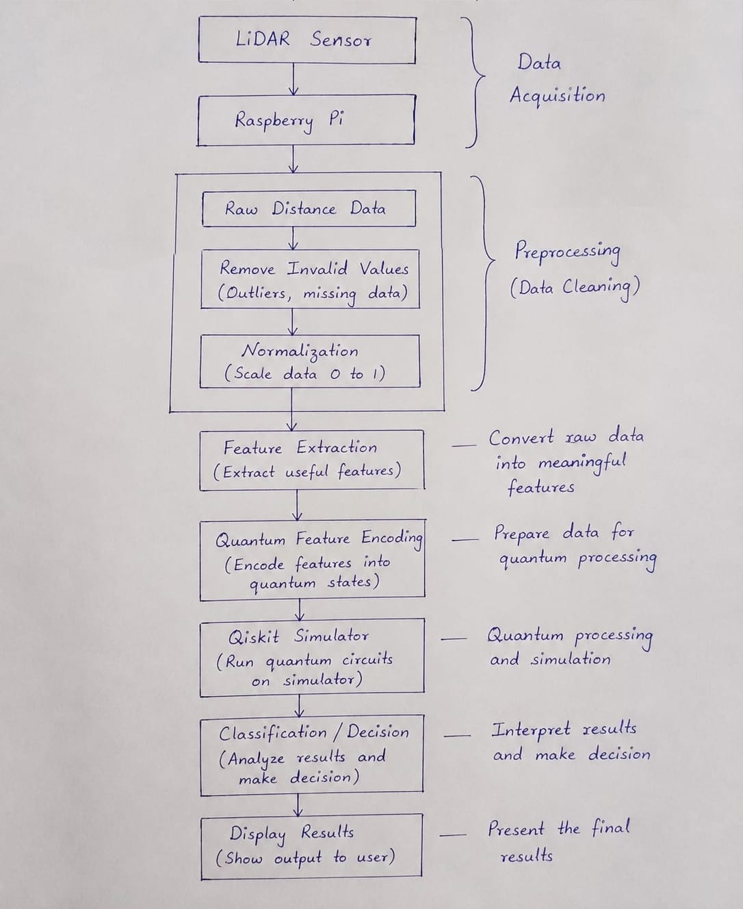
Workflow

Slide 5
Next Week Goals
Finalize the hardware components required for the prototype.
Procure the selected LiDAR sensor and other components.
Interface the LiDAR sensor with Raspberry Pi 5.
Read and verify LiDAR distance measurements.
Implement data preprocessing and feature extraction.
Begin Qiskit implementation using sample data.
Test the complete software pipeline.

Slide 6
Who Will Do What?
Harish Ganapathy S
Finalize hardware design.
Complete the software architecture documentation.
Ramya S
Interface the LiDAR sensor with Raspberry Pi 5.
Test sensor communication.
Verify hardware performance.
Akash S
Implement data preprocessing.
Develop feature extraction.
Start Qiskit implementation using processed data.
Analyze the initial results.

Slide 7


